Slide 1

Development of a Web-Based Smart Store Management System for Retail Store
Yu Yue 1001956834
Supervisor: Asst. Prof. Dr. Shayla Islam
Second Marker: Asst. Prof. Dr. Chloe Thong Chee Ling

Slide 2
Table of Content
Introduction
Background
Observations & Comparisons of existing Systems
Related Work
Problem Statement
Aim
Objectives
Justification
Scope
Research Method
Development Method
Major Milestone
Constraints and Assumptions
Resources
External Bodies Involved
Project Plan
References

Slide 3
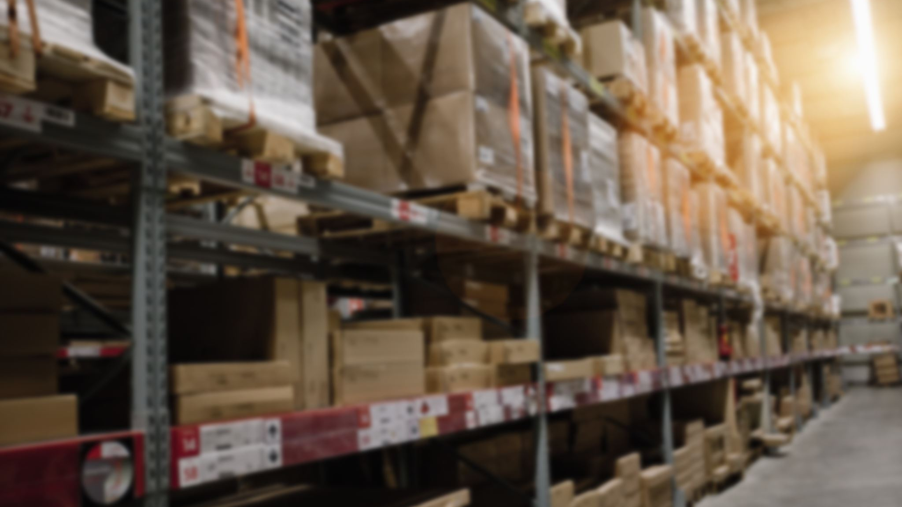
Introduction
Today, stores are all around everyone. It is a traditional retail business organization, while the modern retail business model is gradually transforming into the new retail. It is a business model derived from the new era, with consumers as the core and data and information technology as the retail format. In this paper, I will develop a Web-based intelligent store management system to provide a solution for the management of retail enterprises to effectively improve their adaptability to the online and offline retail business environment, which will be the focus of research and exploration in this paper [1].

Slide 4
Background
The retail industry has a long history of development. By studying the evolution of the global retail industry, it can be found that the goal of retail companies is to obtain more customer traffic, higher purchase rates and higher customer loyalty at lower costs, and people move from physical stores to the Internet and from the Internet to mobile Internet [2]. The industry can only get the most efficient customer traffic by making corresponding changes.
With the rapid development of network information technology, emerging forms of online retailing appear in people's lives, and the establishment of Alibaba in China in 1999, the online retailing model continues to influence and change the shopping behavior of consumers, while the physical retail industry still has many problems such as unreasonable resource allocation and high costs in the development process due to the lack of relevant experience [3]. Therefore, retail enterprises should fully understand the online and offline retail environment and develop a reasonable marketing model based on this, which is the main problem facing the development of retail enterprises at present

Slide 5
Observations & Comparisons of existing Systems
No | System Title | Introduction | Advantage Features
1 | IQmetrix | iQmetrix provides integrated POS, retail management and software solutions that help wireless, repair and specialty retailers create an outstanding customer experience [4]. | 1. Scalable 2. Easy to use 3. Advanced Security 4. No more outdated technologies
2 | Springboard | Springboard Retail's point-of-sale and retail management software provides retailers with data to support more rational sales strategies [5]. | 1. Data driven 2. Built-in flexibility 3. Easy Export
3 | Retail Pro | Retail Pro is the global leader in retail management software, known worldwide for its rich functionality, cross-country capabilities, and unmatched flexibility [6]. | 1. Internationalization 2. Mining complex data 3. Inventory management
4 | ChainDrive | ChainDrive is composed entirely of retail process components and is a single-source omnichannel software on which users can base their management activities and implement many operations [5]. | 1. Mobile Friendly 2. Loss Prevention 3. Employee Productivity 4. Track Store Performance 5. Using Data Mining Techniques

Slide 6
Related Work
The system proposed by G Divya Jyothi and K Navya is a store management system Web Application based on Web server development. In order to overcome the problem of out-of-stock in stores, the author proposes a store management framework [7].
Fan Wei and Zhang Qian of Xi'an Petroleum University in China designed the system for the online store. The author describes in detail how the system will implement these functions, how to design the relationship between various entities, and a detailed database design [8].
Md. Abdur Ra​​him and Rafat Ara, Department of Computer Science and Engineering, German University, Bangladesh. They recommend implementing point-of-sale software that is widely used in retail businesses. The app generates all necessary buy and sell reports, reducing human error and paperwork [9].

Slide 7
Problem Statement
1. High operation and management costs of traditional retail stores
In today's high growth of the Internet retail channel, the speed of commodity renewal is increasingly fast, while in traditional retail stores, shelves and shelves of goods, as well as a variety of data reports queried by manual statistical query records are very time-consuming , which makes the store operation and management costs are high. In addition, the stores themselves have high comprehensive operating costs, such as labor, management, and resource issues, and can only make high-cost investments and compressed returns [10].

Slide 8
Problem Statement (con’t)
2. Traditional offline retail stores have a limited number of customers to reach
Today, due to the development of the Covid-19 virus epidemic, more and more people are changing their shopping habits. Instead of shopping at offline events, they are shopping online. In traditional retail stores, consumers can only purchase items that exist in the store at a defined time and place. This makes the number of customers in traditional offline retail stores limited [11].

Slide 9
Problem Statement (con’t)
3. Difficulty in aggregating merchandise statistics in traditional retail stores
For traditional retail stores, the majority of their operations are labor-based and the traditional calculation methods do not have excellent statistical aggregation capabilities [18]. It makes the merchandise statistics prone to computational errors when counting a large number of goods [12].

Slide 10
Problem Statement (con’t)
4. Difficulty in managing inventory in traditional retail stores
Retail stores generally invest more in merchandise inventory, which also generates significant inventory management costs and large amounts of working capital. The traditional inventory management model is often fragmented merchandise management, information resources cannot be shared, general management of merchandise is difficult to implement, requires high g inventory capital, and it takes a long time to waste to find merchandise [13].

Slide 11

Aim
The aim of this project is to design and develop a web-based smart store management system application. With the help of this application, it helps retail store managers to improve management efficiency and performance.

Slide 12
Objectives
1. To study the current existing store management system and determine the strengths and weaknesses of the current system.
2. To develop a web-based smart store management system application:
To design a store management system that combines online and offline to solve the high operating cost of retail stores.
To develop store distribution, express distribution, and other functions for retail stores to solve the limited number of customers in offline retail stores.
To develop the function of online real-time entry and update of inventory information for the system to solve the statistical problem of commodity information in traditional retail stores.
To develop the functions of allocation, replenishment, return, and inventory for the system to solve the difficult problem of inventory management in traditional retail stores.
3. To evaluate the performance of the developed web-based smart store management system and compare it with existing systems.

Slide 13
Justification
After observing and comparing the existing systems IQmetrix, Springboard, Retail Pro, ChainDrive, reviewing various research articles under related topics, namely Jyothi, G. and Navya, K., 2017 [8], Wei, F. and Zhang, Q., 2018 [9], Rahim, MA, & Ara, R. 2019 [10], I found many aspects of these research articles relevant to my project idea by summarizing the problems and limitations in the existing systems to identify significant contributions to my research in order to get some ideas in this context that will be used to develop new projects and to determine the to-be-developed system's current state in this study [14].
In addition, the intention to design an integrated online and offline store management system to solve existing retail store inventory management challenges is the biggest reason that most attracted my attention to this topic, and by developing this project it will allow me to apply the knowledge and skills I learned in my lectures to my future work. As this final year project has evolved, it has provided new experiences for me to gain more knowledge.

Slide 14
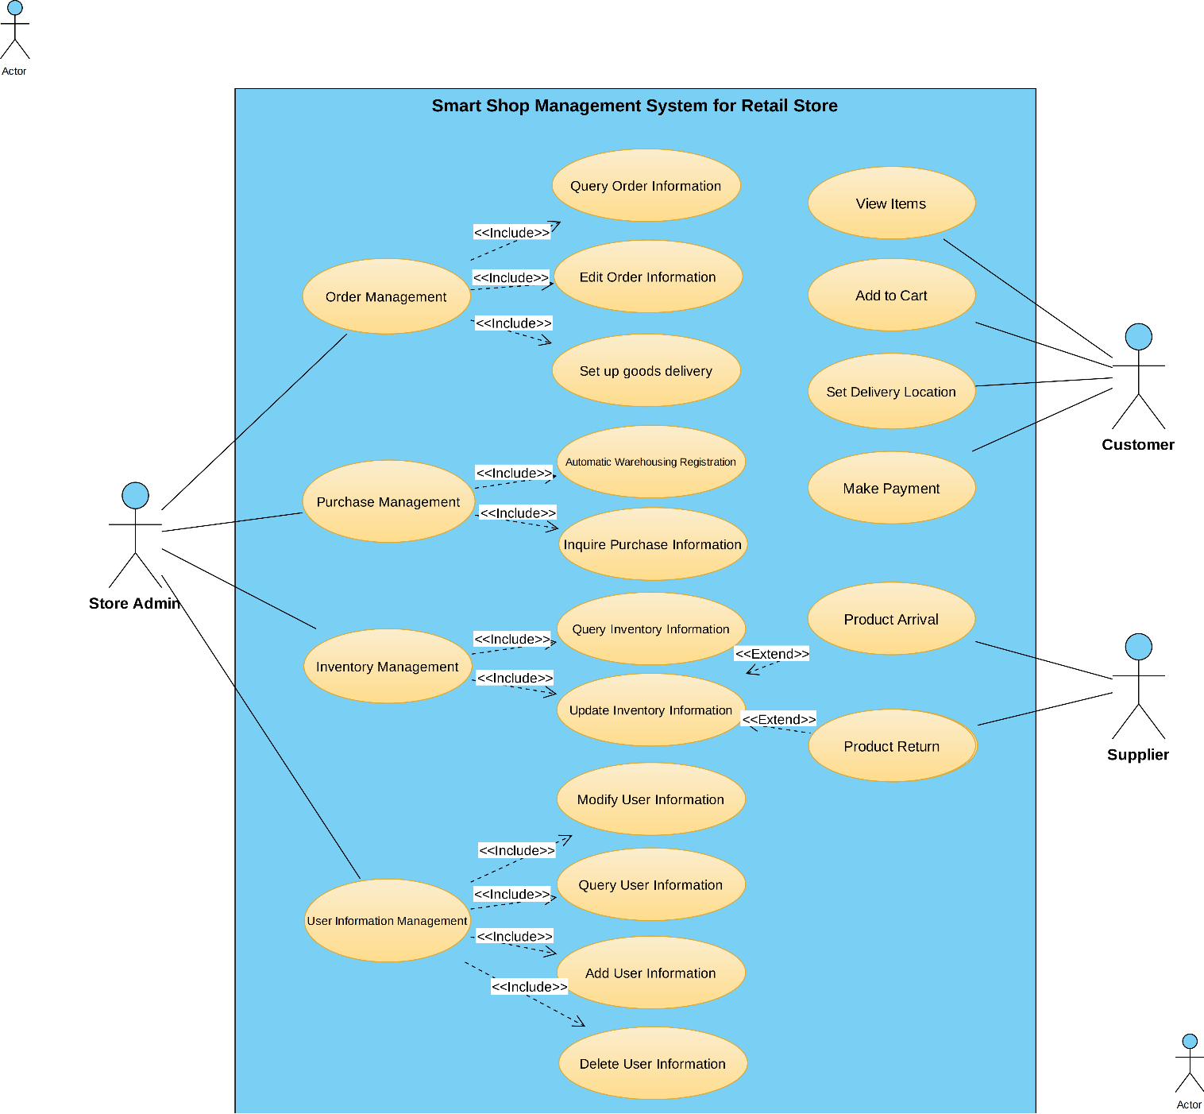
Scope

Slide 15
Research Method
Literature Review
Online Survey

Slide 16
Development Method-SDLC
Requirement Analysis
System Design
Implementation
Testing
Deployment
Maintenance

Slide 17
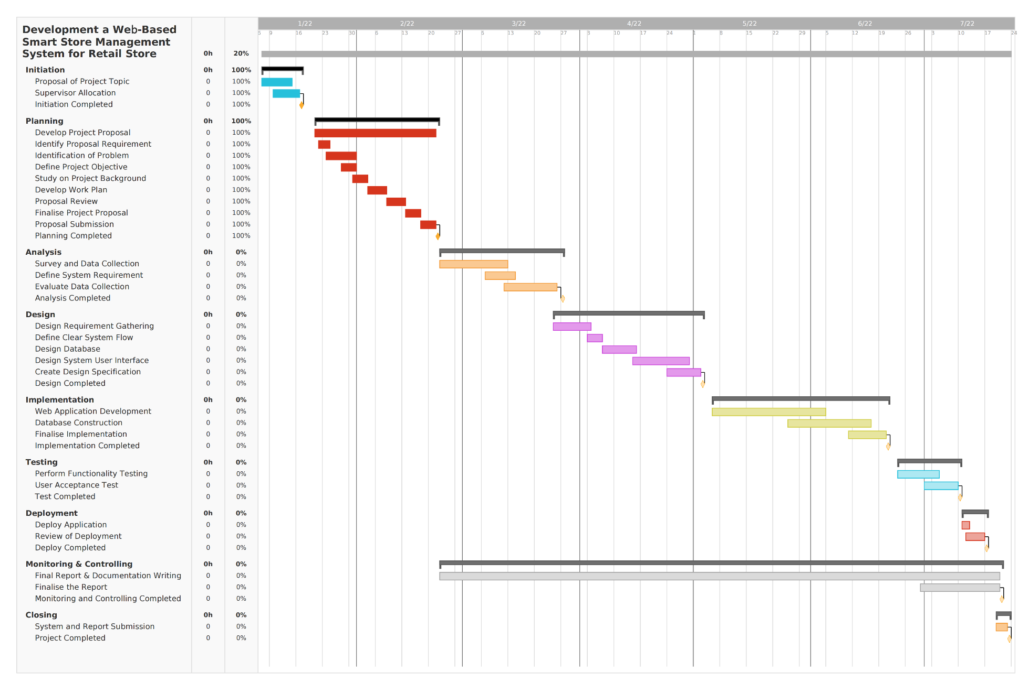
Major Milestone (Gantt Chart)

Slide 18
Constraints and Assumptions
System Constraints
External Constraints
Assumptions
System Assumptions

Slide 19

Resources
Hardware
Processor: Intel Core i7-11800H @ 2.30GHz
Graphics: NVIDIA GeForce RTX 3070 Laptop GPU
Memory: 16GB
Hard Disk: 1TB

Slide 20









Software

Slide 21

External Bodies Involved
China Beijing Zhongke Zhuoxin Software Testing Technology Center was established on December 24, 2010. It is a national research institution directly under the Ministry of Industry and Information Technology. The company's business scope includes: software product testing, technology development, technical testing, technical consulting, computer system services, etc [15]. In the test stage of the system development life cycle, after the development of the smart store management system project is completed, it will cooperate with Zhongke Zhuoxin Software Testing Technology Center to run the system to conduct a comprehensive user acceptance test UAT and quality assurance test QAT to verify the project goals whether the requirements are met.
Additionally, after testing is complete, the product will be deployed in partnership with new offline retail stores.

Slide 22
Project Plan
Phase and Task Name | Duration | Start Date | Finish Date
Development of a Web-Based Smart Store Management System for Retail Store | 202 days | Fri 7/1/22 | Fri 28/7/22
Initiation | 11 days | Fri 7/1/22 | Fri 21/1/22
Proposal of Project Topic | 4 days | Fri 7/1/22 | Tue 10/1/22
Supervisor Allocation | 1 day | Tue 10/1/22 | Tue 10/1/22
Initiation Completed | 0 day | Fri 21/1/22 | Fri 21/1/22
Planning | 28 days | Fri 21/1/22 | Tue 18/2/22
Develop Project Proposal | 28 days | Fri 21/1/22 | Tue 18/2/22
Identify Proposal Requirement | 2 days | Sat 22/1/22 | Sun 23/1/22
Identification of Problem | 4 days | Sat 22/1/22 | Tue 25/1/22
Define Project Objective | 4 days | Sat 22/1/22 | Tue 25/1/22
Study on Project Background | 5 days | Fri 28/1/22 | Tue 1/2/22
Develop Work Plan | 5 days | Fri 4/2/22 | Tue 8/2/22
Proposal Review | 2 days | Sat 12/2/22 | Sat 13/2/22
Finalise Project Proposal | 6 days | Sun 13/2/22 | Fri 18/2/22

Slide 23
Project Plan (con’t)
Phase and Task Name | Duration | Start Date | Finish Date
Proposal Submission | 1 day | Fri 18/2/22 | Fri 18/2/22
Planning Completed | 0 day | Fri 18/2/22 | Fri 18/2/22
Analysis | 30 days | Fri 22/2/22 | Tue 22/3/22
Survey and Data Collection | 14 days | Fri 25/2/22 | Tue 8/3/22
Define System Requirement | 5 days | Mon 7/3/22 | Fri 11/3/22
Evaluate Data Collection | 15 days | Tue 8/3/22 | Tue 22/3/22
Analysis Completed | 0 day | Tue 22/3/22 | Tue 22/3/22
Design | 39 days | Fri 25/3/22 | Tue 3/5/22
Design Requirement Gathering | 7 days | Fri 25/3/22 | Fri 1/4/22
Define Clear System Flow | 4 days | Sat 2/4/22 | Wed 6/4/22
Design Database | 7 days | Thu 7/4/22 | Thu 14/4/22
Design System User Interface | 12 days | Fri 15/4/22 | Tue 26/4/22
Create Design Specification | 7 days | Wed 27/4/22 | Tue 3/5/22
Design Completed | 0 day | Tue 3/5/22 | Tue 3/5/22

Slide 24
Project Plan (con’t)
Phase and Task Name | Duration | Start Date | Finish Date
Implementation | 45 days | Fri 6/5/22 | Tue 21/6/22
Web Application Development | 20 days | Fri 6/5/22 | Thu 26/5/22
Database Construction | 18 days | Thu 26/5/22 | Mon 13/6/22
Finalise Implementation | 7 days | Tue 14/6/22 | Tue 21/6/22
Implementation Completed | 0 day | Tue 21/6/22 | Tue 21/6/22
Testing | 17 days | Fri 24/6/22 | Mon 11/7/22
Perform functionality testing | 7 days | Fri 24/6/22 | Fri 1/7/22
User Acceptance Test | 10 days | Fri 1/7/22 | Mon 11/7/22
Testing Completed | 0 day | Mon 11/7/22 | Mon 11/7/22
Deployment | 5 days | Mon 11/7/22 | Thu 15/7/22
Deploy Application | 1 day | Mon 11/7/22 | Mon 11/7/22
Review of Deployment | 5 days | Mon 11/7/22 | Fri 15/7/22
Deploy Completed | 0 day | Fir 15/7/22 | Fri 15/7/22
Monitoring & Controlling | 150 days | Sun 22/2/22 | Mon 20/7/22
Final Report & Documentation Writing | 138 days | Sun 20/2/22 | Fri 10/7/22
Finalize the Report | 12 days | Fri 10/7/22 | Mon 20/7/22
Monitoring and Controlling Completed | 0 days | Mon 20/7/22 | Mon 20/7/22
Closing | 1 day | Tue 21/7/22 | Tue 22/7/22
System and Report Submission | 1 day | Fri 21/7/22 | Fri 22/7/22
Project Completed | 0 day | Fri 22/7/22 | Fri 22/7/22

Slide 25
References
[1] Yin, Y., Zhang, R., Gao, H., & Xi, M. (2019). New retail business analysis and modeling: A Taobao case study. IEEE Transactions on Computational Social Systems, 6(5), 1126-1137.
[2] Wang, S., & Zhang, Y. (2015). The new retail economy of Shanghai. Growth and Change, 36(1), 41-73.
[3] Mou, S., Robb, D. J., & DeHoratius, N. (2018). Retail store operations: Literature review and research directions. European Journal of Operational Research, 265(2), 399-422.
[4] Luce, S. (2015). Revolutionizing Retail: Workers, Political Action, and Social Change by Kendra Coulter. Labour/Le Travail, 75(1), 265-266.
[5] Pulga, A., 2022. Introducing: iQmetrix Inside Sales. [online] Iqmetrix.com. Available at: <https://www.iqmetrix.com/blog/introducing-iqmetrix-inside-sales/>.

Slide 26
References (con’t)
[6] PAT RESEARCH: B2B Reviews, Buying Guides & Best Practices. 2022. Top 7 Retail Management Software in 2022 - Reviews, Features, Pricing, Comparison - PAT RESEARCH: B2B Reviews, Buying Guides & Best Practices. [online] Available at: <https://www.predictiveanalyticstoday.com/top-retail-management-software/>.
[7] PAT RESEARCH: B2B Reviews, Buying Guides & Best Practices. 2022. ChainDrive in 2022 - Reviews, Features, Pricing, Comparison - PAT RESEARCH: B2B Reviews, Buying Guides & Best Practices. [online] Available at: <https://www.predictiveanalyticstoday.com/chaindrive/>
[8] Jyothi, G. D., & Navya, K. (2017, December). Design and implementation of a store management system. In 2017 International Conference on Intelligent Sustainable Systems (ICISS) (pp. 1149-1151). IEEE.
[9] Wei, F., & Zhang, Q. (2018). Design and implementation of online shopping system based on B/S Model. In MATEC Web of Conferences (Vol. 246, p. 03033). EDP Sciences.
[10] Rahim, M. A., & Ara, R. Implementation of Point of Sale Software in Mobile Shop.

Slide 27
References (con’t)
[11] Willems, K., Verhulst, N., & Brengman, M. (2021). How COVID-19 could accelerate the adoption of new retail technologies and enhance the (E-) servicescape. In The Future of Service Post-COVID-19 Pandemic, Volume 2 (pp. 103-134). Springer, Singapore.
[12] Ilias, J., Kasim, S., Hassan, R., Mahdin, H., Ramli, A. A., Fudzee, M. F. M., & Aizi, M. (2018). At-Thoyyib Shop Inventory Management System. Acta Informatica Malaysia (AIM), 2(2), 12-16.
[13] Tanamal, R., Nurdiansyah, Y., & Firdaus, F. (2020). Inventory Support System for Retail Shop. In E3S Web of Conferences (Vol. 188, p. 00020). EDP Sciences.
[14] Wang, D., Yang, Y., & Wang, Y. (2021). Optimization of Distribution Path considering Cost and Customer Satisfaction under New Retail Modes. Journal of Advanced Transportation, 2021.
[15] Ts.4thservice.org. 2022. Beijing Zhongke Zhuoxin Software Testing Technology Center, Details of Service Providers [online] Available at: <http://ts.4thservice.org/portal/ vipAndSolution/detail/e2dec50d6aca4a28916e18dfffe0c9c6/1>.

Slide 28

Thank you for watching

